Slide 1

Visual pollution

Slide 2
Prpare the data
Identify the data
Deal with negative values of coordination for each image
Transfer the coordination from pascal to YOLO coordination
Normalize the images
Arrange the image for training and testing to our YOLO model
Check the annotations for the images

Slide 3
Train the model
Split the training dataset into training and validation parts
Train our model
Test our model
Report the coordination for submission file
Build an API for model deployment (See demo link for check)
Another test in our model using relevant data

Slide 4

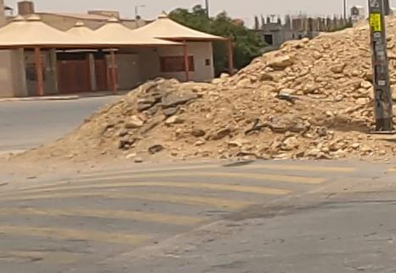
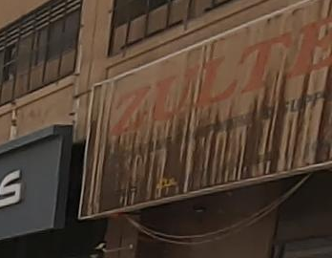
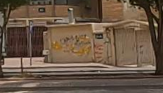
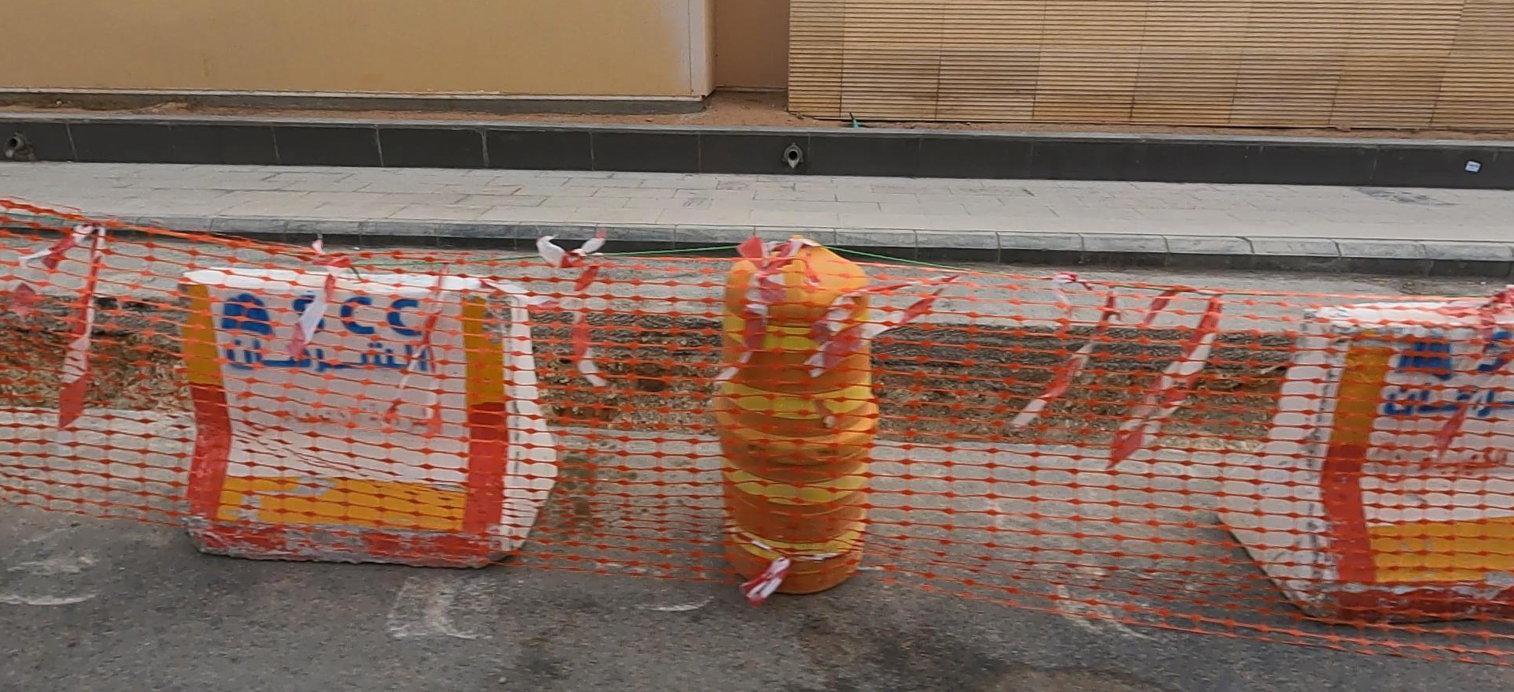
The input image

Slide 5
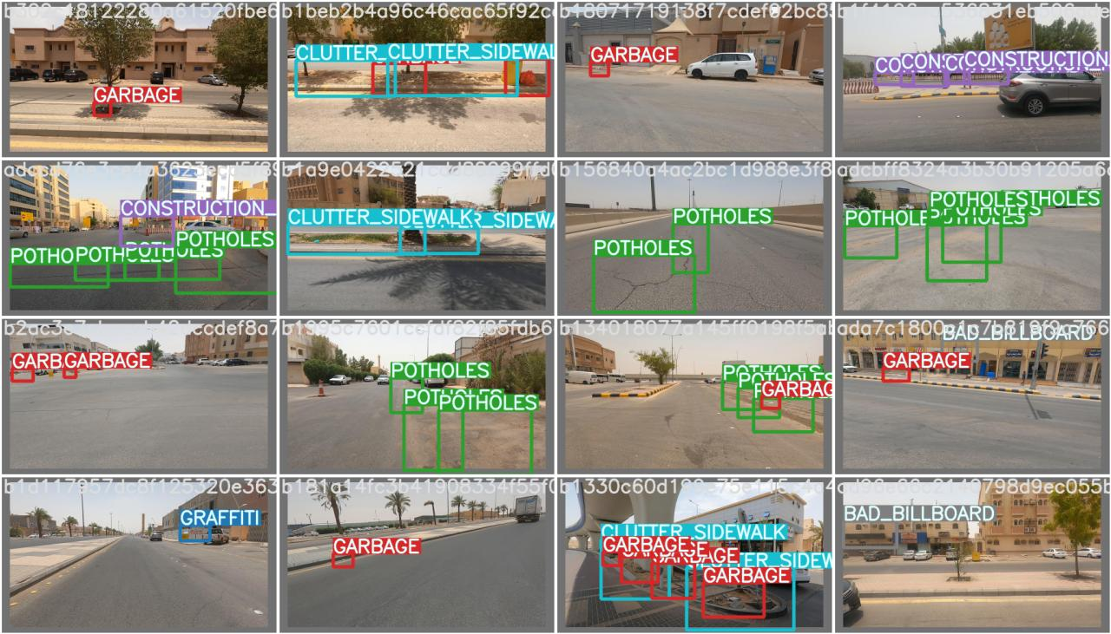
Testing our model with sample example

Slide 6
tools used to detect the object in our model
Open CV
Pandas
Numpy
PyTorch
YOLOV7
Matplotlib
SciPy

Slide 7
Team members
Abdulmalik Abdulaziz Almonif (Leader)
Saleh Mohammed Alsaeed
Hamad Abdullah Albaqi
Reem Majed Alduraihem
Meshael Ali Asiri

